Slide 2
OVERALL STRUCTURE
Teens could participate a variety of ways:
Read or listen to books, audiobooks, magazines, etc and turn in reading logs (up to 2 per teen)
Attend teen events at the library
Each activity earns each teen a prize drawing ticket – the more they participate, the more chances they have to win a grand prize
Program: June 1 – Labor Day

Slide 3
IMPACT!!!
Best attended teen events we’d had all year!
New teens attending events
Teens could choose how they wanted to participate, then participate as much or as little as they liked!
Twice as many teens than expected signed up – we had to place a second order for prize books (given away at the beginning this year)

Slide 4
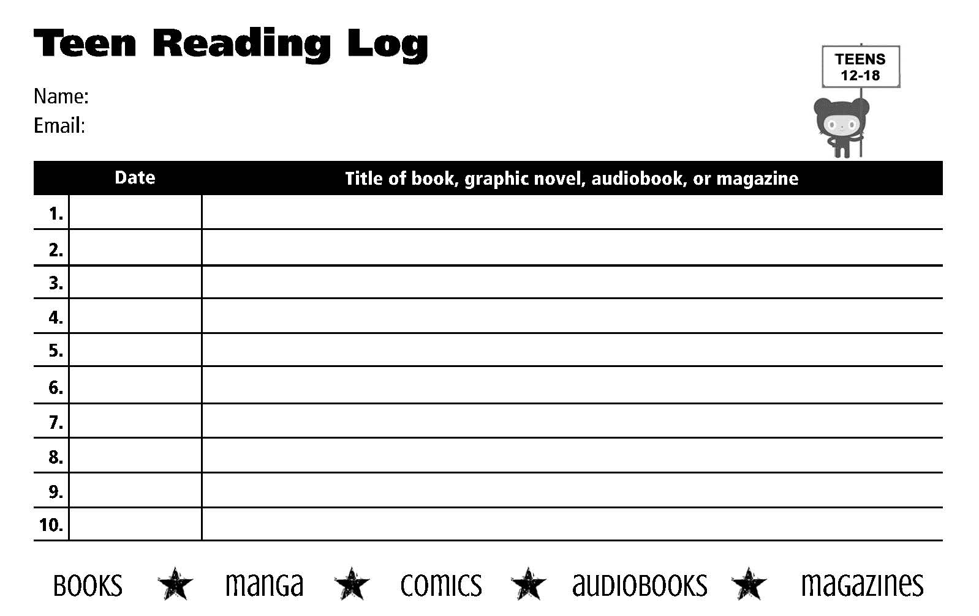
Read & Listen This Summer

Slide 5
Tuesday June 16, 1-3pm
Attend Teen Summer Reading Events!

Slide 7
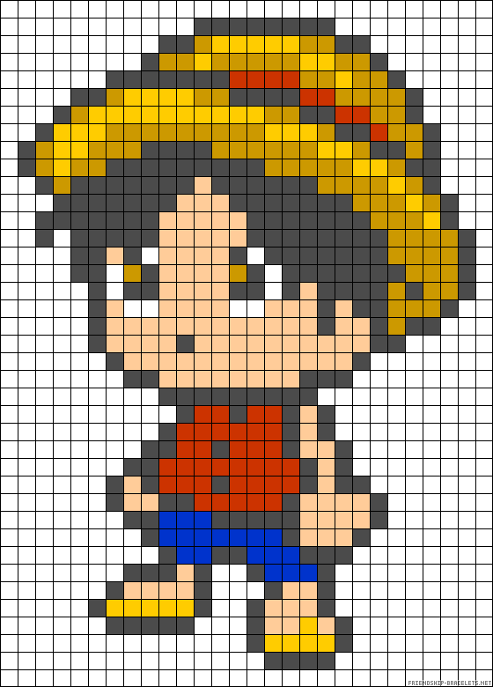
Animanga Extravaganza | July 1 @ 3:30

Slide 8
Teen Days | 1st & 3rd Tuesdays | 1-3pm

Slide 9
Special Teen Summer Book Club

Slide 10
Enter to Win!!!

Slide 11
☺ See you at the library! ☺
Kristy Kemper Hodge, Teen Librarian

